Slide 1
Design Patterns
Ahmed Hesham

Slide 2
Pattern Groups
Creational
Structural
Behavioral

Slide 3
Creational Patterns
Construct objects
Objects are decoupled from their implementing systems

Slide 4
Factory
Exposes methods for creating objects
Subclasses decide on which class to instantiate

Slide 5
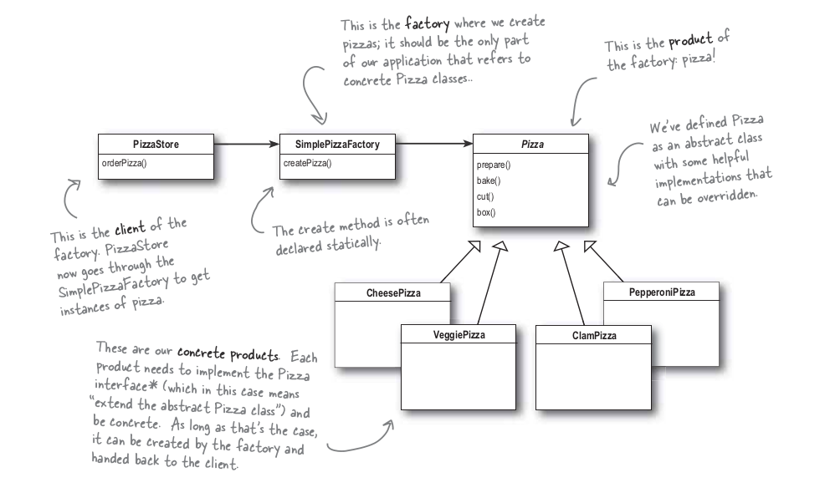

Slide 6
Abstract Factory
Provides an interface for creating families of similar/dependent objects
Does not specify their concrete classes
Delegates the creation to the concrete class

Slide 7
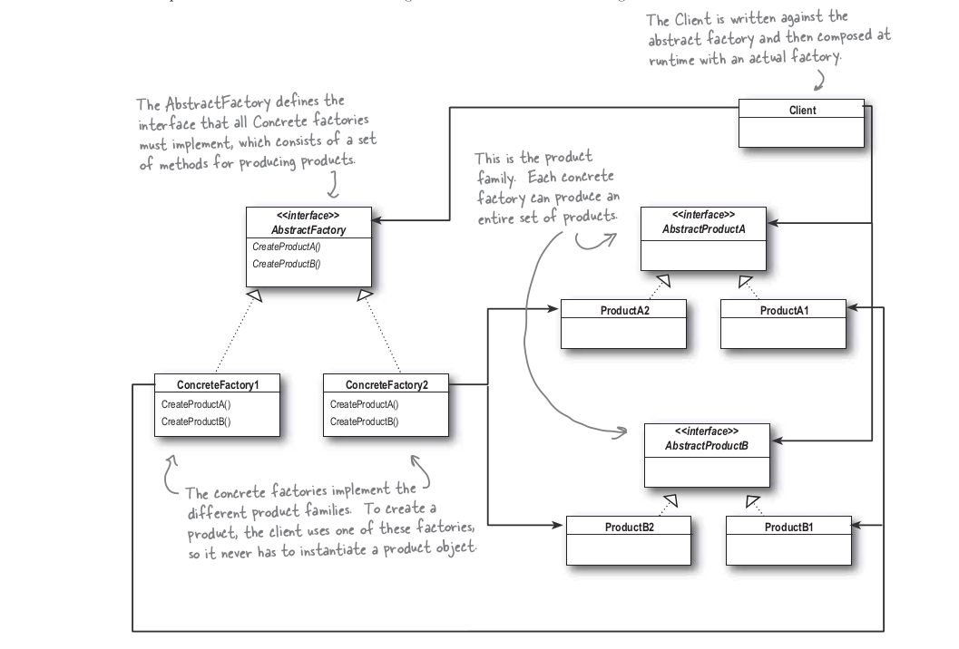

Slide 8
Builder
Allows object to be constructed in steps

Slide 9
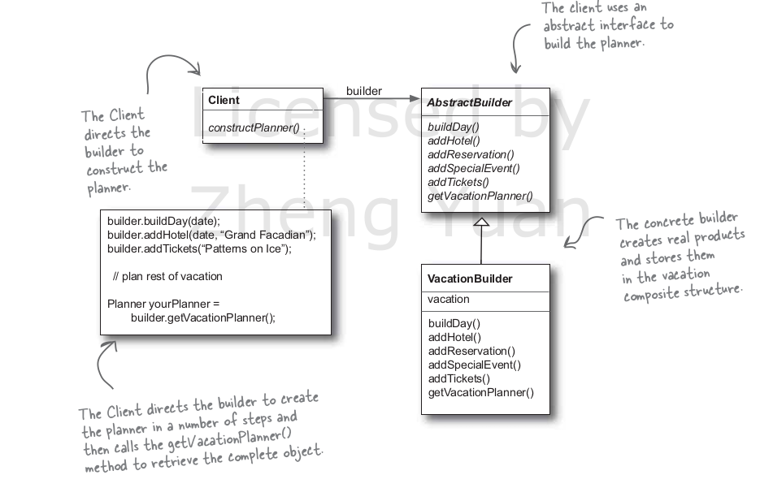

Slide 10
Prototype
Instances of an object are created by copying other objects
Used when creating an instance of a class is complex or expensive

Slide 11
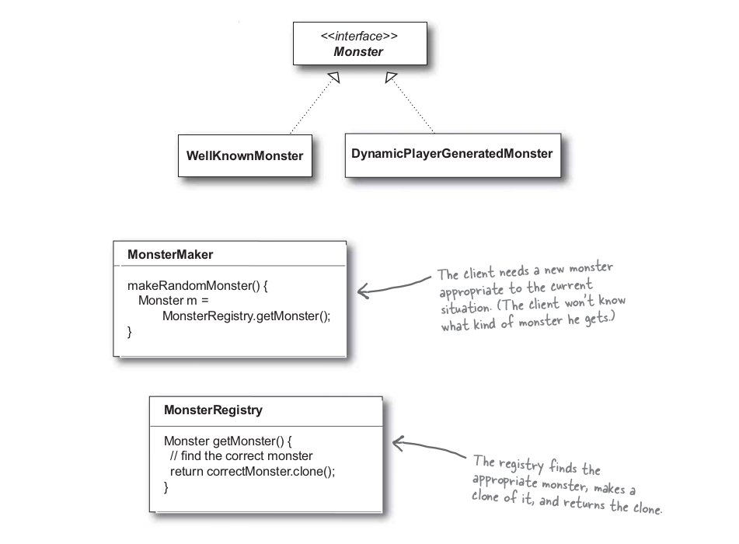

Slide 12
Singleton
Ensures that one instance of an object exists throughout the system
Exists in two forms:
  Eager
  Lazy

Slide 13
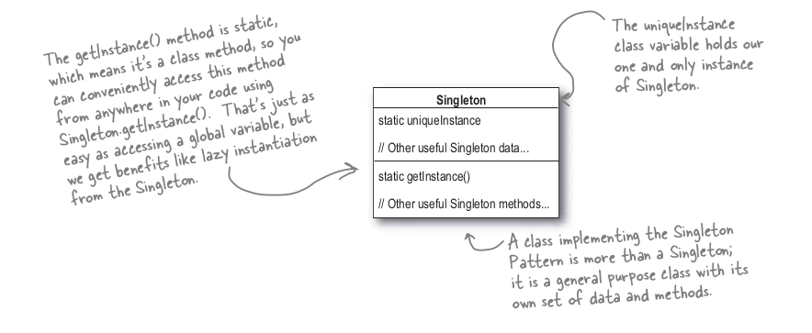

Slide 14
Structural Patterns
Used to form large object structures between many different objects

Slide 15
Adapter
Allows different classes to work together by acting as a binding glue

Slide 16
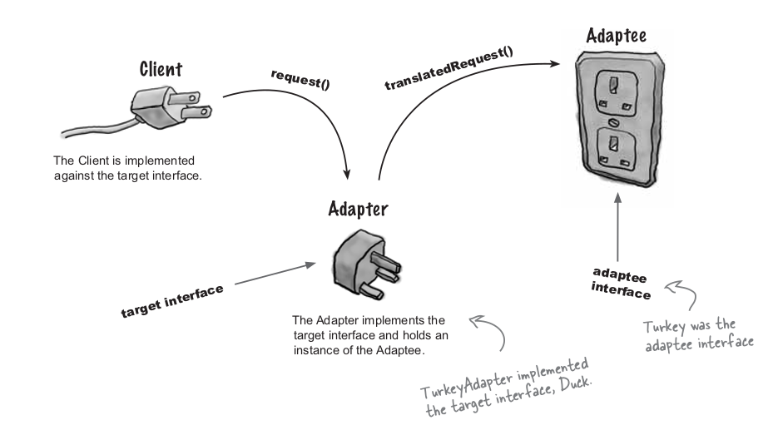

Slide 17
Bridge
Allows for variable implementation of an object
Offers abstraction of object by creating a class hierarchy for implementation and abstraction

Slide 18
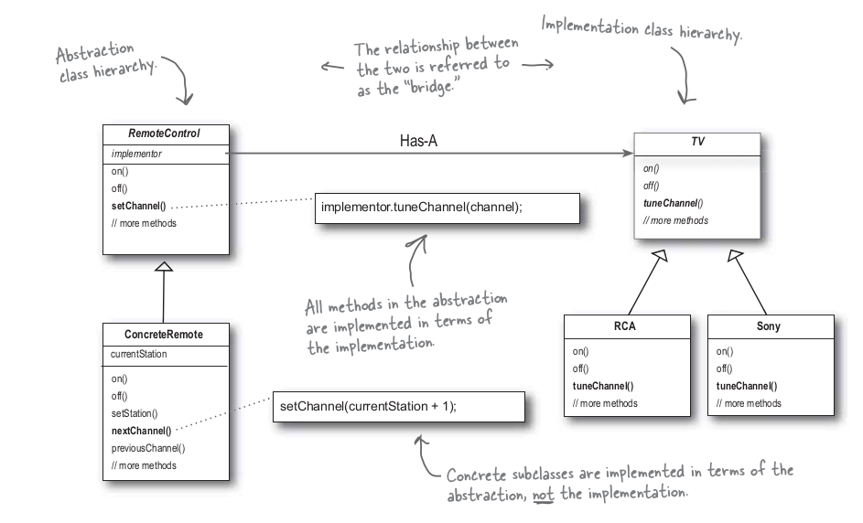

Slide 19
Composite
Models the objects into a tree
Operations can be applied to each sub-trees or all objects at once
Does not use inheritance

Slide 20
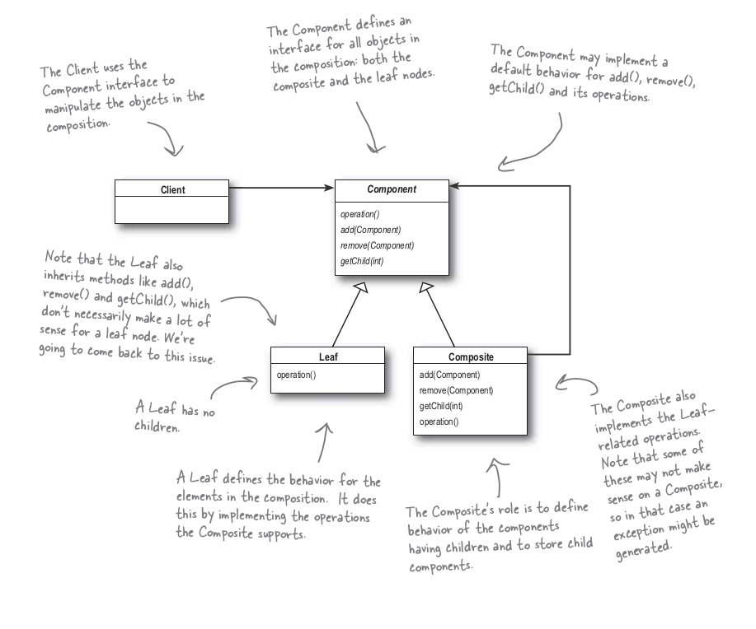

Slide 21
Decorator
Behavior can be added to an individual object, either statically or dynamically
Add behavior does not affect the behavior of other objects from the same class

Slide 22
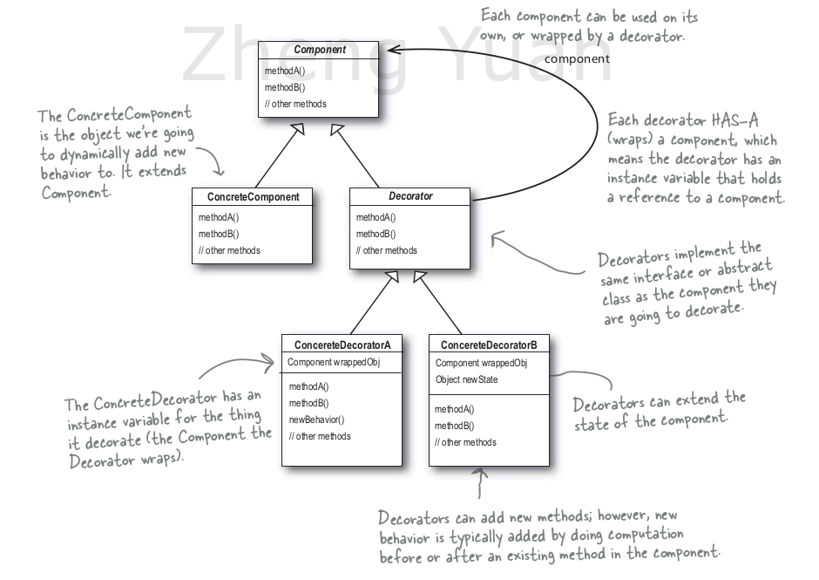

Slide 23
Facade
Hides the complexities of the larger system
Provides a simpler interface to the client
Typically involves a single wrapper class that accesses the system on behalf of the facade client

Slide 24
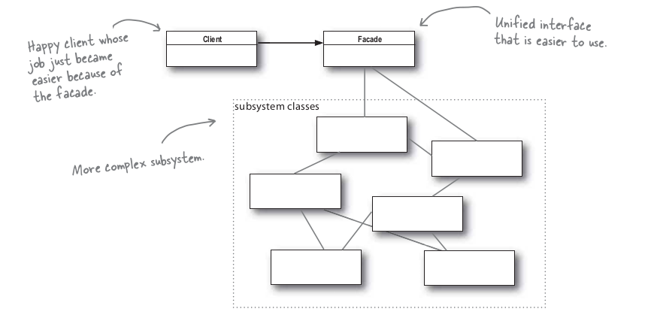

Slide 25
Flyweight
Shares common data with other objects rather than replicating it in each object
Used to minimize memory usage

Slide 26
Flyweight – example
A landscape design program that can render trees as object based age
Don’t store age in each tree
Encapsulate all similar aged trees in a data structure

Slide 27
Proxy
A placeholder for another object to access it
Can instantiate objects where needed

Slide 28
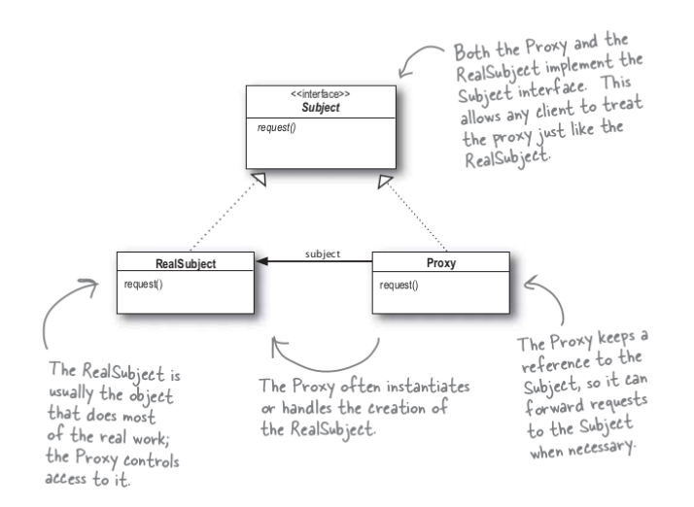

Slide 29
Behavioral Patterns
Manages:
  Algorithms
  Relationships and responsibilities between objects

Slide 30
Chain Of Responsibility
Chain of handlers
Object passed down chain to appropriate handler to be computed

Slide 31
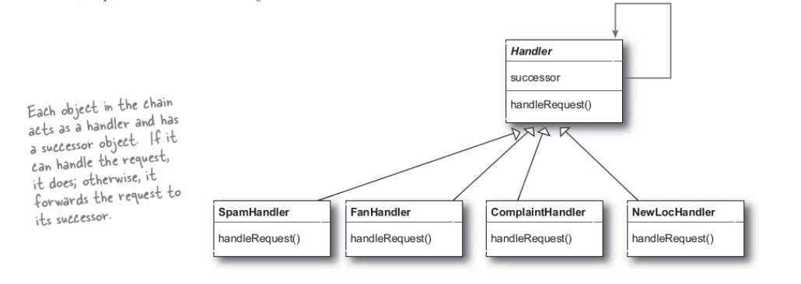

Slide 32
Command
Eases construction of components in system by:
  Encapsulating all information needed to execute at later time
  Delegating method calls when appropriate without having to know class or method parameters

Slide 33
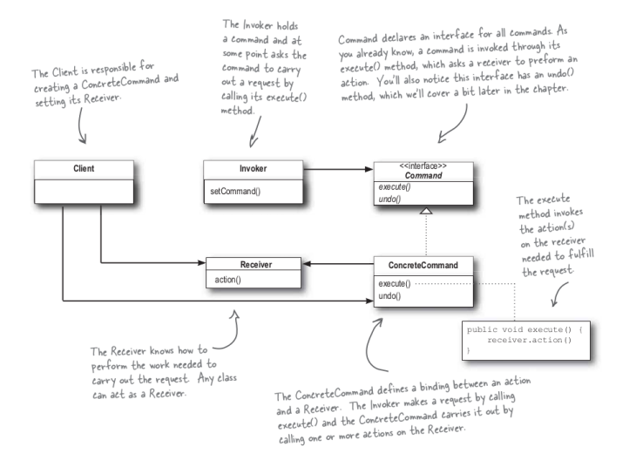

Slide 34
Interpreter
Specifies how to evaluate sentences in a language usually through the use of context free grammars (CFGs)
Example: Python

Slide 35
Iterator
Utilizes an object (iterator) to traverse the content of another object

Slide 36
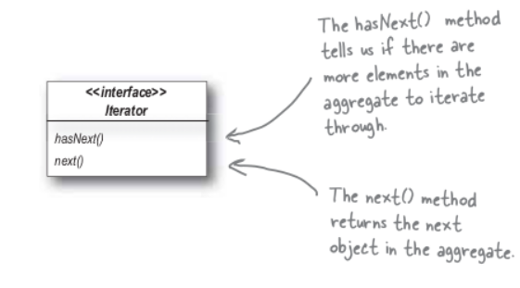

Slide 37
Mediator
Centralized communication platform between objects
Objects no longer communicate directly with each other
Reduces dependencies between objects

Slide 38
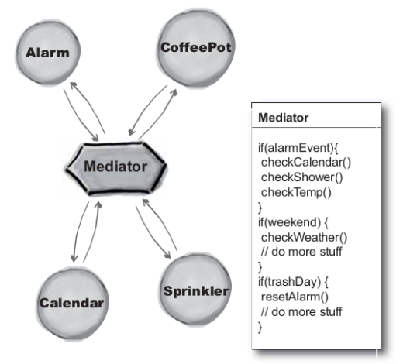

Slide 39
Memento
Provides the ability to restore an object to its previous state

Slide 40
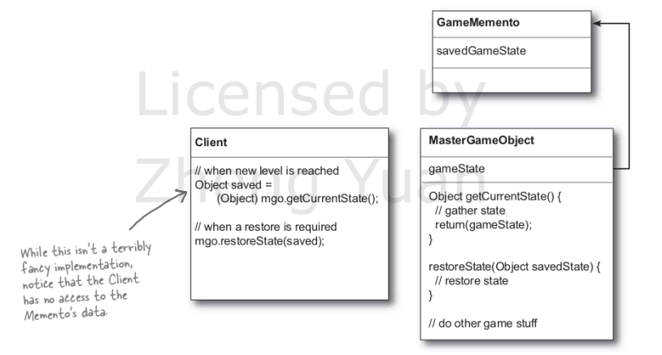

Slide 41
Observer
Defines a one to many relation between objects so that when one object changes, all of its dependents are notified

Slide 42
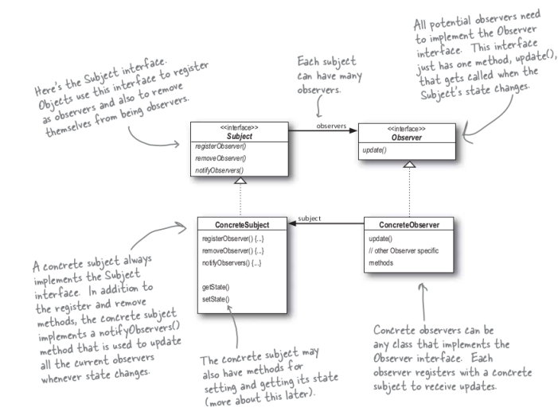

Slide 43
State
Allows an object to alter its behavior when its internal state changes

Slide 44
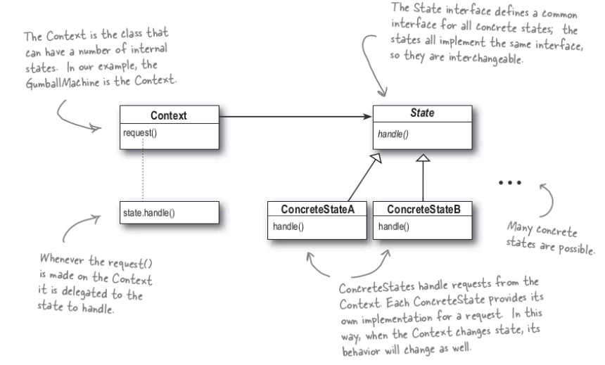

Slide 45
Template Method
Defines the skeleton of an algorithm in one step, deferring some steps to the other classes
Allows subclasses to redefine certain steps without changing the algorithm structure

Slide 46
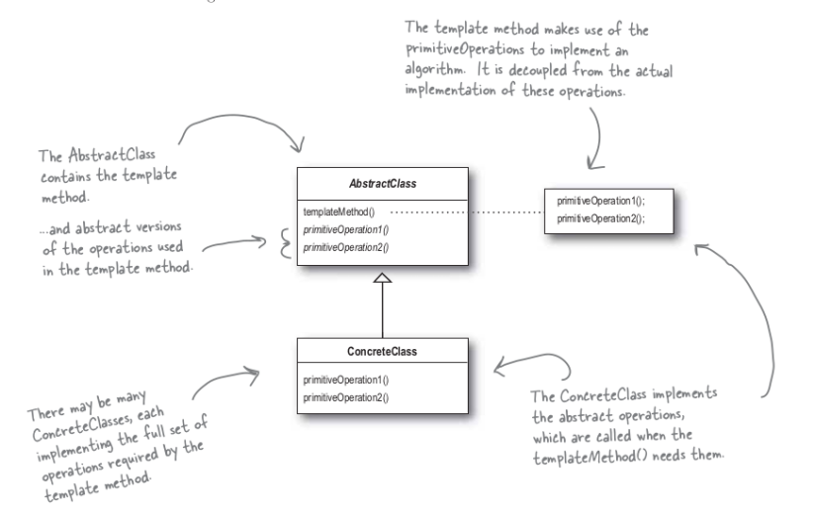

Slide 47
Visitor
Allows adding new virtual functions to a family of classes, without modifying the classes

Slide 48
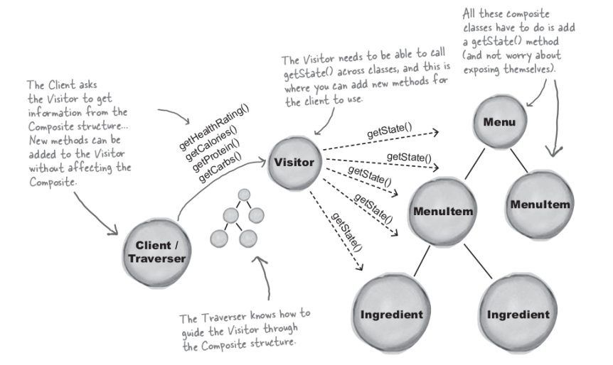

Slide 49
Modern Design Patterns
New design patterns have emerged to conform to the rise of microservices

Slide 50
Aggregator
A common unit named the aggregator requests all the data for the incoming request
Data is generated from different sources and merged at the aggregator

Slide 51
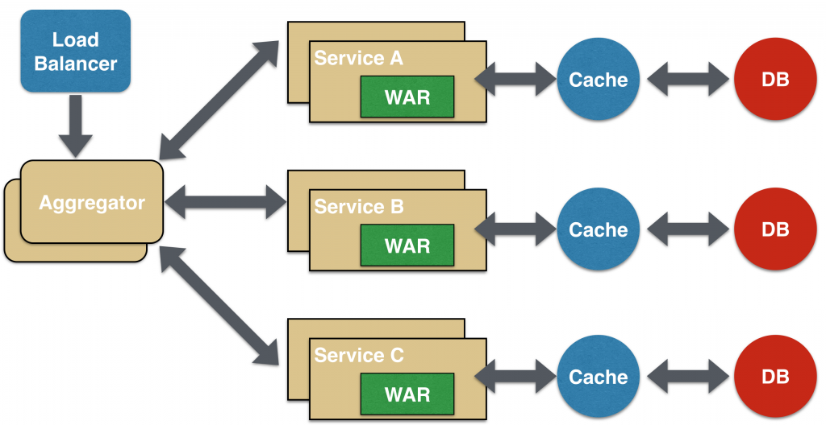

Slide 52
Anticorruption Layer
A new layer is added between two subsystems in an application that translate requests from either side
Usually used when migrating a subsystem to newer communication form
Adds an overhead for each communication

Slide 53
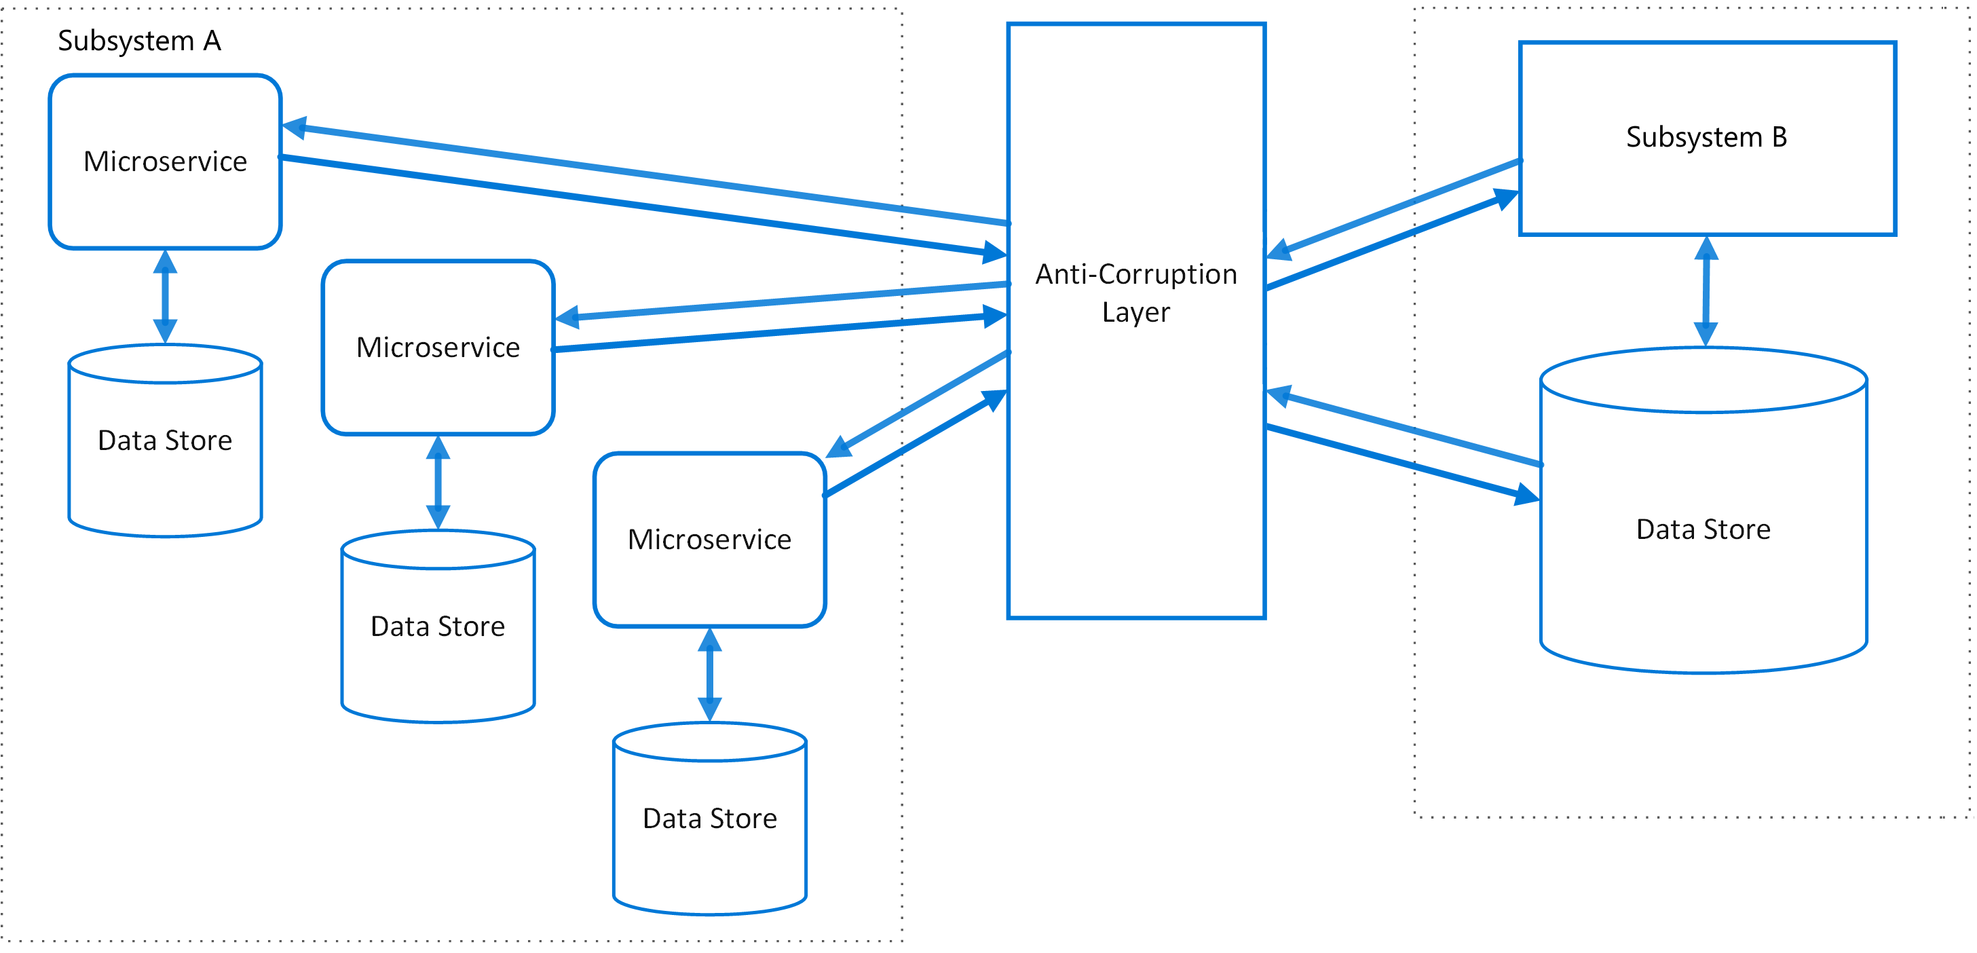

Slide 54
Sidecar
Encapsulates components of an application into separate processes or containers
Avoids a single process monopolizing resources
Allows applications to be composed of heterogeneous components and technologies

Slide 55
Strangler
Incrementally migrates a legacy system by replacing specific pieces of functionality with new applications and services
A new facade layer is developed above the system to route the requests to the correct place

Slide 56
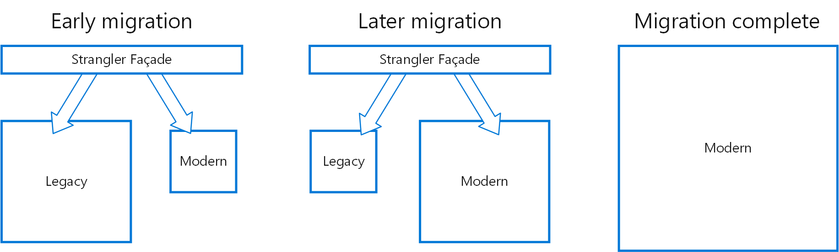

Slide 57
Ambassador
Create helper services that send network requests on behalf of an application
Can be thought of as an out-of-process proxy that is co-located with the client
Handles:
  Resending requests on failures
  Monitoring system
  Circuit breaking (disabling all future requests until application is up again from a failure)

Slide 59
Bulkhead
Used in failure tolerance
Partitions services into different groups/servers
In case of failure, some functionality is still preserved

Slide 60
Any questions?

